Slide 1
Asymptotic Notations

Slide 2
Analysis of Algorithms
An algorithm is a finite set of precise instructions for performing a computation or for solving a problem.
What is the goal of analysis of algorithms?
  To compare algorithms mainly in terms of running time but also in terms of other factors (e.g., memory requirements, programmer's effort etc.)
What do we mean by running time analysis?
  Determine how running time increases as the size of the problem increases.

Slide 3
Input Size
Input size (number of elements in the input)
  size of an array
  polynomial degree
  # of elements in a matrix
  # of bits in the binary representation of the input
  vertices and edges in a graph

Slide 4
Types of Analysis
Worst case
  Provides an upper bound on running time
  An absolute guarantee that the algorithm would not run longer, no matter what the inputs are
Best case
  Provides a lower bound on running time
  Input is the one for which the algorithm runs the fastest
Average case
  Provides a prediction about the running time
  Assumes that the input is random

Slide 5
Ideal Solution
Express running time as a function of the input size n (i.e., f(n)).
Compare different functions corresponding to running times.
Such an analysis is independent of machine time, programming style, etc.

Slide 6
Asymptotic Analysis
To compare two algorithms with running times f(n) and g(n), we need a rough measure that characterizes how fast each function grows.
Hint: use rate of growth
Compare functions in the limit, that is, asymptotically!
  (i.e., for large values of n)

Slide 7
Asymptotic Notation
O notation: asymptotic “less than”:
  f(n)=O(g(n)) implies: f(n) “≤” g(n)
Ω notation: asymptotic “greater than”:
  f(n)= Ω (g(n)) implies: f(n) “≥” g(n)
Θ notation: asymptotic “equality”:
  f(n)= Θ (g(n)) implies: f(n) “=” g(n)

Slide 8
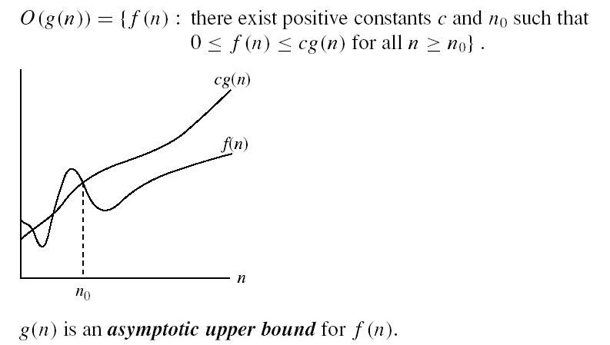
Asymptotic notations
O-notation

Slide 9
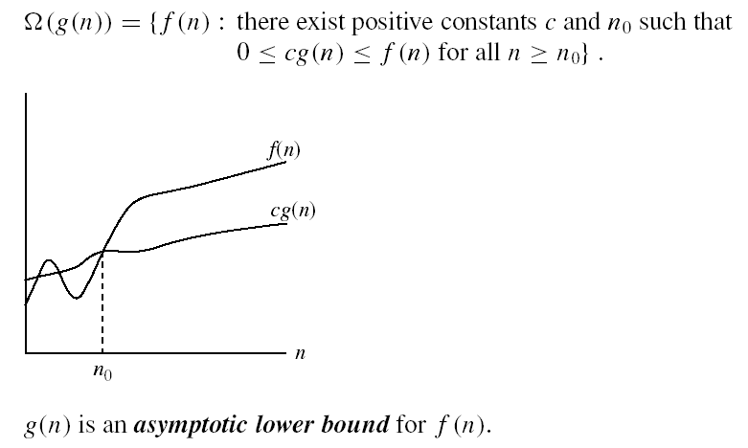
Asymptotic notations (cont.)
Ω - notation
Ω(g(n)) is the set of functions with larger or same order of growth as g(n)

Slide 10


Asymptotic notations (cont.)
Θ-notation
Θ(g(n)) is the set of functions with the same order of growth as g(n)

